Slide 1
SOFTWARE ENGINEERING
UNIT – I (Chapter-2) Process: A Generic View
Text Book: Software Engineering, A practitioner’s approach
Roger s. Pressman 6th Edition -McGraw-Hill

Slide 2
Outline
Software Engineering
A Layered Technology
Software Process Framework Framework Activities Umbrella Activities
Capability Maturity Model Integration (CMMI)
Process Patterns
Personal Software Process (PSP)

Slide 3
Software Enginnering
Software Engineering is the establishment and use of sound engineering principles in order to obtain economically software that is reliable and works efficiently on real machines.
The IEEE definition: Software Engineering The application of a systematic, disciplined, quantifiable approach to the development, operation and maintenance of software; that is, the application of engineering to software.

Slide 4
A Layered Technology

Slide 5
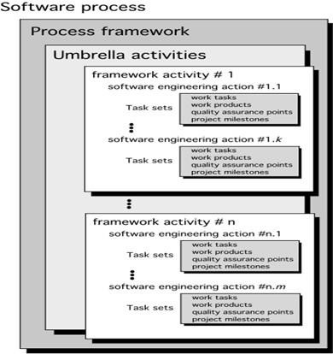
Software Process Framework

Slide 6
Framework Activities
Communication – Involves communication and collaboration with the customer(Stakeholder)
Planning – Technical Tasks, Risks, Resources, work Products to be produced and work schedule
Modeling
Analysis of Requirements
Design
Construction
Code generation
Testing
Deployment

Slide 7
Changing Nature of Software
System software
Application software
Engineering/scientific software
Embedded software
Product-line software
Web-applications
Artificial Intelligence software
Netsourcing
Open source
Also …
Data mining
Cloud Computing
Software for nanotechnologies

Slide 8
Umbrella Activities
Software Project Tracking and Control
Risk Management
Software Quality Assurance
Formal Technical Reviews
Software Configuration Management
Reusability Management
Measurement
Work product preparation and production

Slide 9
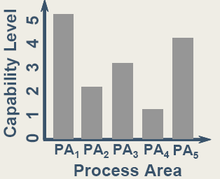
Capability Maturity Model Integration (CMMI)
Two different Models Continuous Model Staged Model
Continuous Model Two-dimensional Each Process Area is assessed against Specific Goals” and the “Specific Practices” required to achieve these goals. Defines a set of Generic Goals and Generic Practices for each Process Area
Ex: Project Planning

Slide 10
Continuous Model Capability Levels
Level 0: Incomplete
Level 1: Performed
Level 2: Managed – Organizational Policy
Level 3: Defined – Standards (Work Products)
Level 4: Quantitatively managed
Level 5: Optimized

Slide 11
Process Areas Required to achieve Maturity Level
Level | Focus | Process Area
Performed
Managed | Basic Project Management | Requirement Management Project Planning Project Monitoring & Control Measurement & Analysis Process & Product Quality Assurance Configuration Management
Defined | Process standardization | Verification & Validation Organizational Process Focus Organizational Training Risk Management Integrated Teaming
Quantitatively Managed | Quantitative Management | Organizational Process Performance Quantitative Project Management
Optimizing | Continuous Process Improvement | Organizational Innovation & Development Causal Analysis & Resolution.

Slide 12
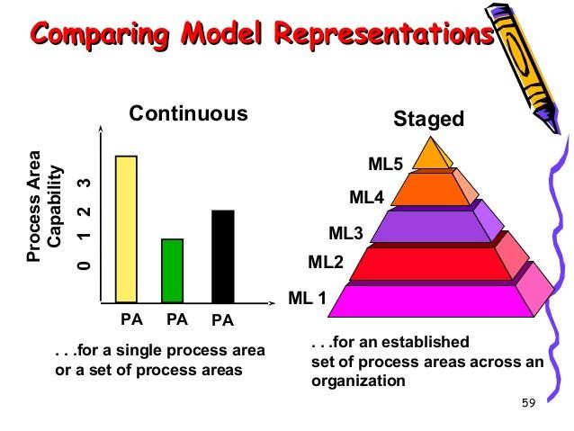

Slide 13
Process Patterns
Process patterns define a set of activities, actions, work tasks, work products and related behaviors required to develop computer software. Process Pattern provides a Template Pattern Name - Ex: Customer Communication Intent - Objective
Type Task Patterns - Ex: Requirements Gathering Stage Patterns – Ex: Communication Phase Patterns – Ex: Spiral Model
Initial Context
Problem
Solution
Resulting Context
Related Patterns
Known Uses/Examples

Slide 14
Process Assessment
The process should be assessed to ensure that it meets a set of basic process criteria that have been shown to be essential for a successful software engineering.
Many different assessment options are available:
SCAMPI – Standard CMMI Assessment Method for Process
Improvement
CBA IPI – CMM-Based Appraisal for Internal Process Improvement
ISO 9001:2000 for software
Plan – Do – Check - Act

Slide 15
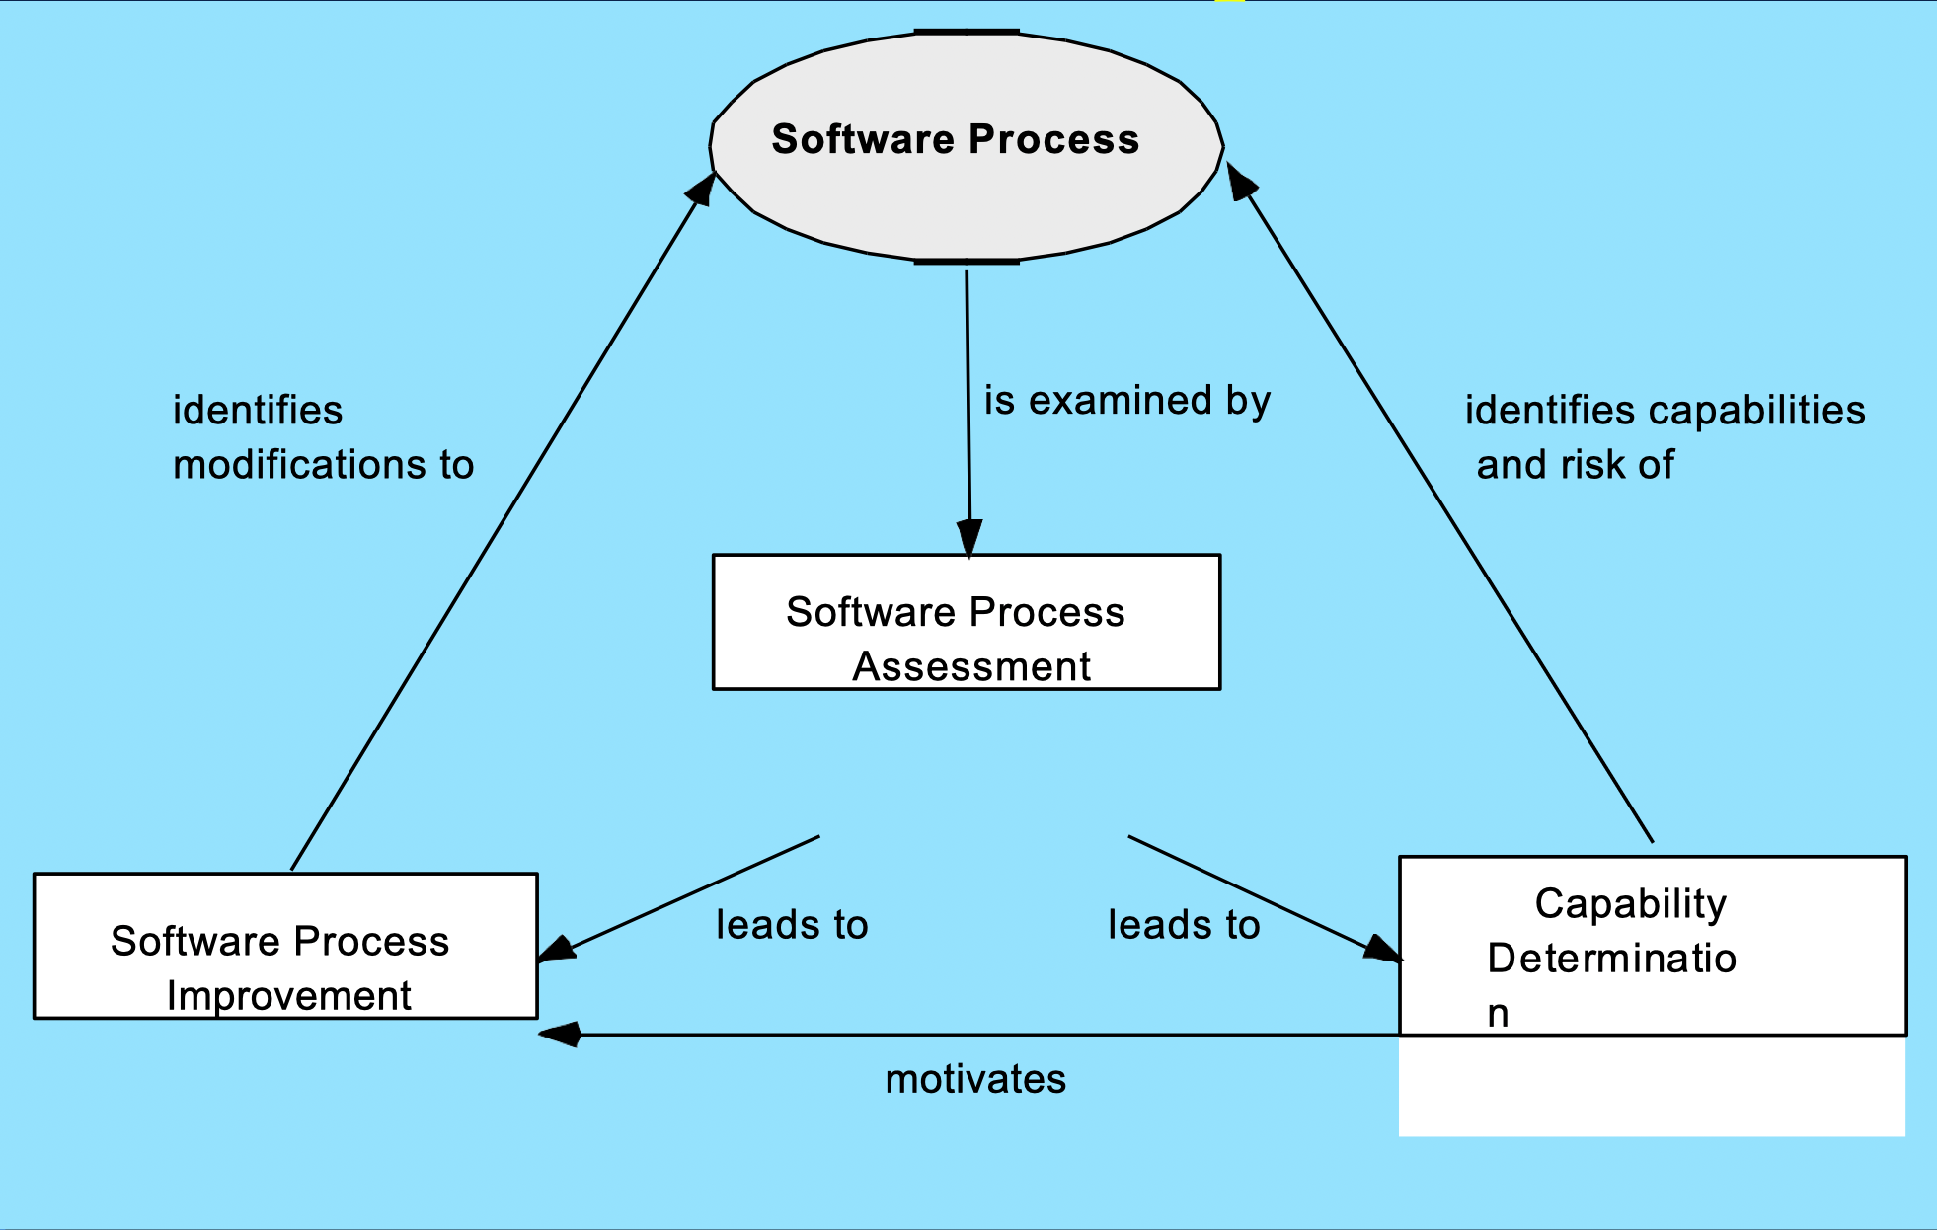
Assessment and Improvement

Slide 16
Personal Software Process (PSP)
Recommends five framework activities:
Planning
High-level design
High-level design review
Development
Postmortem
stresses the need for each software engineer to identify errors early and as important to understand the types of errors

Slide 17
Team Software Process (TSP)
Each project is “launched” using a “script” that defines the tasks to be accomplished
Teams are self-directed
Measurement is encouraged
Measures are analyzed with the intent of improving the team process
Launch
High-level design
Implementation
Integration
Test
Postmortem

Slide 18
Process, Product & Project
Set of steps to be followed to develop a product is called Software Process
The execution of activities for some specific user needs is a Software Project
Outcome of software process is called Product

Slide 19
Process, Product & Project
Set of steps to be followed to develop a product is called Software Process
The execution of activities for some specific user needs is a Software Project
Outcome of software process is called Product

Slide 20
Any questions?

Slide 21
Thank you

Slide 22
Scan The QR for More Info

