Slide 1
SOFTWARE ENGINEERING
UNIT –III (Part - 1)
Design Engineering & Architectural Design
Text Book: Software Engineering, A practitioner’s approach
Roger s. Pressman 6th Edition -McGraw-Hill

Slide 2
Syllabus
• Design Engineering : Design process and Design quality, Design concepts, The design model
• Architectural design : Software architecture, Data design, Architectural styles and patterns

Slide 3
Design Concepts
Software Design -- An iterative process
Transforming requirements into a“blueprint” for constructing the software.

Slide 4
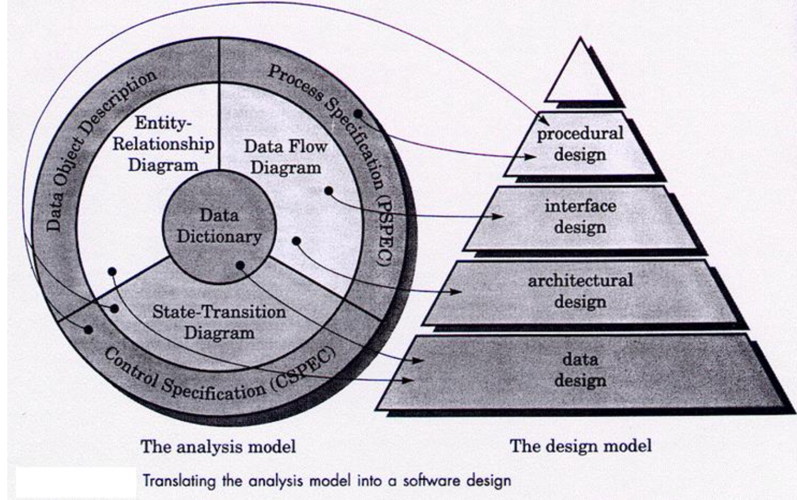
Relation of Analysis to Design

Slide 5
The Design Model
• Data Design
– Transforms information domain model into data structures required to implement software
• Architectural Design
– Defines relationship among the major structural elements of a program
• Interface Design
– Describes how the software communicates with itself, to systems that interact with it and with humans.
• Procedural/Component Design
– Transforms structural elements of the architecture into a procedural description of software construction

Slide 6
The Design Process
• Design must enable all requirements of the analysis model and implicit needs of the customer to be met
• Design must be readable and an understandable guide for coders, testers and maintainers
• The design should address the data, functional and behavioral domains of implementation

Slide 7
Design Guidelines/ Characteristics
• Design should exhibit a hierarchical organization
Design should be modular (Logically partitioned into subsystems)
Design should contain distinct data representations of data, architecture, interfaces and components
Design should lead to data structures that are appropriate for the classes to be implemented
Design should lead to components that exhibit independent functional characteristics
Design should lead to Interfaces that reduce the Complexity
Design should be obtained from a repeatable method, driven by analysis
Design should be represented using a notation that 7
communicates its meaning

Slide 8
Design Concepts
✓ [Abstraction ✓ Architecture ✓ Patterns ✓ Modularity ✓Information Hiding
✓Functional Independence
✓ Refinement
✓ Refactoring

Slide 9
Design Concepts Abstraction
“Abstraction permits one to concentrate on a problem at some level of abstraction without regard to low level details”
Procedural Abstraction – Instructions are given in a named sequence – Each instruction has a limited function
Data Abstraction – This is a named collection of data that describes a data object
Control Abstraction – A program control mechanism without specifying
internal details, e.g., semaphore

Slide 10
Architecture
The overall structure of the software and the ways in which that structure provides conceptual integrity for a system
(Structural organization of program components (modules) and their interconnection)
Architecture Models a. Structural Models
-- An organized collection of program components
b. Framework Models
-- Represents the design in more abstract way
c. Dynamic Models
-- Represents the behavioral aspects indicating changes as a function of external events
d. Process Models
-- Focus on the design of the business or technical process

Slide 11
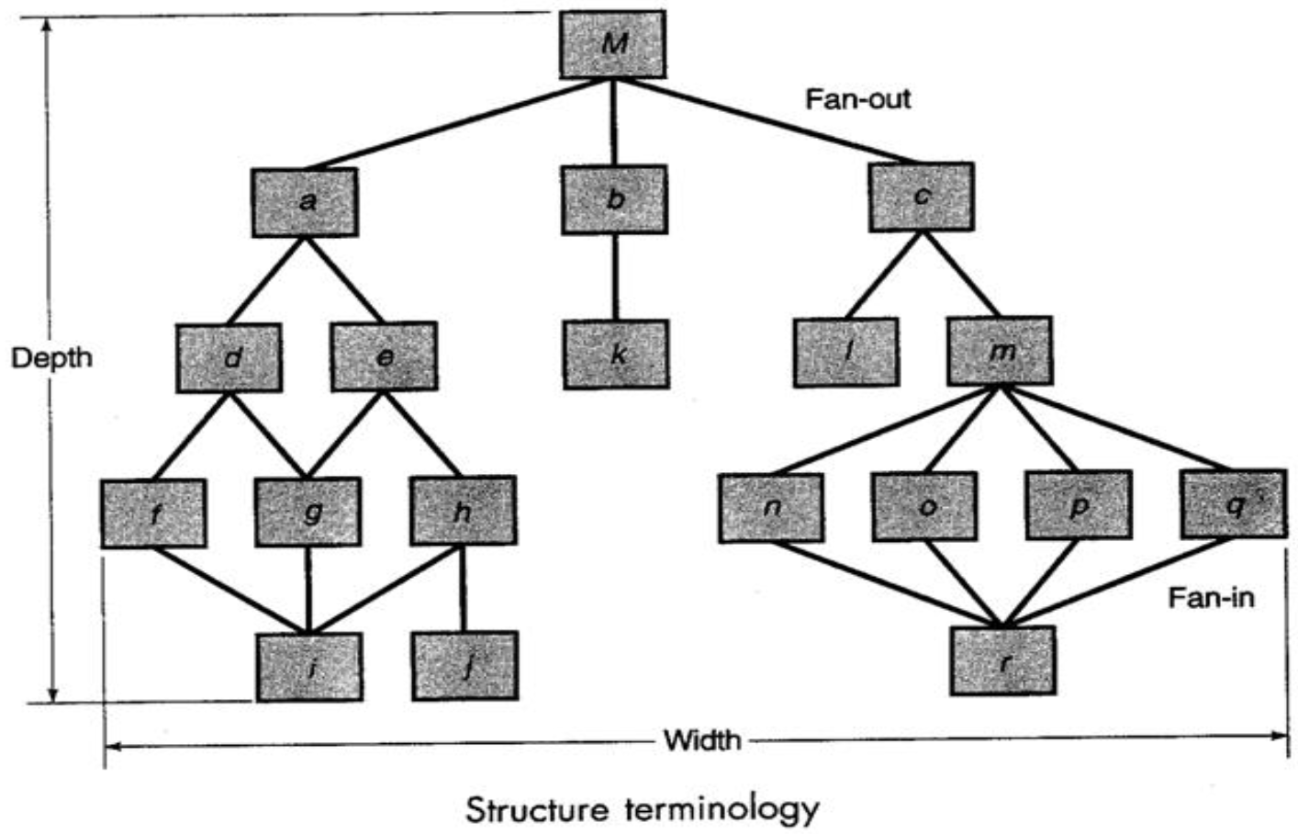
Structural Diagrams

Slide 12
Patterns
A Pattern is named nugget of insight which conveys the essence of a proven solution to a recurring problem within a context
Provides a description to enables a designer to determine:
➢ Whether the pattern is applicable to the current work
➢ Whether the pattern can be reused
➢ Whether the pattern can serve as a guide for developing a similar but functionally or structurally different pattern

Slide 13
Modularity
Software is divided into separately named and
addressable components called modules
• Follows “divide and conquer” concept, a complex problem is broken down into several manageable pieces
• Let p1 and p2 be two program parts and E the effort to solve the problem. Then,
E(p1+p2) > E(p1)+E(p2) • A need to divide software into optimal sized modules

Slide 14
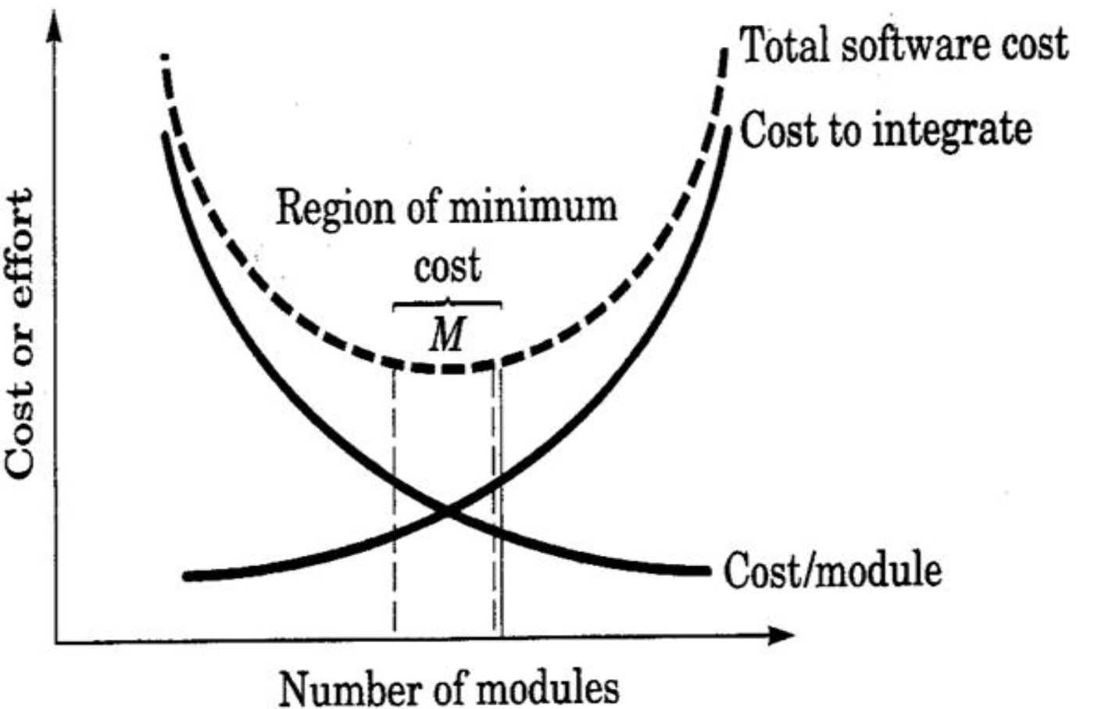
Modularity & Software Cost

Slide 15
Modularity
Objectives of modularity in a design method
• Modular Decomposability
– Provide a systematic mechanism to decompose a problem into subproblems
• Modular Composability – Enable reuse of existing components
• Modular Understandability
– Can the module be understood as a standalone unit? Then it is easier to understand and
change.

Slide 16
Modularity
• Modular Continuity
– If small changes to the system requirements result in changes to individual modules, rather than system-wide changes, the impact of the side effects is reduced
• Modular Protection
– If there is an error in the module, then those errors are localized and not spread to other modules

Slide 17
Information Hiding
• Information contained within a module is inaccessible to other modules who do not need such information
• Achieved by defining a set of Independent modules that communicate with one another only that information necessary to achieve S/W function
• Provides the greatest benefits when modifications are required during testing and later
• Errors introduced during modification are less likely to propagate to other location within the S/W

Slide 18
Functional Independence
A direct outgrowth of Modularity, abstraction and information hiding.
Achieved by developing a module with single minded function and an aversion to excessive interaction with other modules.
Easier to develop and have simple interface
Easier to maintain because secondary effects caused by design or code modification are limited, error propagation is reduced and reusable modules are possible.
Independence is assessed by two quantitative criterias: 1. Cohesion 2. Coupling Cohesion -- Relative functional strength of a module Coupling -- Relative interdependence among modules

Slide 19
Refinement & Refactoring
REFINEMENT
Process of elaboration from high level abstraction to the lowest level abstraction
High level abstraction begins with a statement of functions
Refinement causes the designer to elaborate providing more and more details at successive level of abstractions
Abstraction and refinement are complementary concepts. REFACTORING
Organization technique that simplifies the design of a component without changing its function or behavior.
Examines for redundancy, unused design elements and inefficient or unnecessary algorithms

Slide 20
The Design Model
Viewed in two different dimensions as process dimension and abstract dimension.
Process dimension indicates the evolution of the design model as design tasks are executed as part of software process.
Abstraction dimension represents the level of details as each element of the analysis model is transformed into design equivalent Data Design elements
Data design creates a model of data that is represented at a high level of abstraction
Refined progressively to more implementation-specific representation for processing by the computer base system
Translation of data model into a database is pivotal to achieving business objective of a system

Slide 21
The Design Model
Architectural design elements
Derived from three sources 1. Information about the application domain of the software
2. Analysis model such as data flow diagrams or analysis classes.
3. Architectural pattern and styles
Interface Design elements
Set of detailed drawings constituting: 1. User interface 2.External interfaces to other systems, devices etc.. 3. Internal interfaces between various components

Slide 22
The Design Model
Component level design elements
• Fully describe the internal details of each software component
• UML diagrams can be used
Deployment level design elements
Indicates how software functionality and subsystem will be allocated within the physical computing environment
UML deployment diagram is developed and refined

Slide 23
ARCHITECTURAL DESIGN

Slide 24
Software Architecture
The software architecture of a program or computing system is the structure or structures of the system, which comprise software components, the externally visible properties of those components and the relationships among them.

Slide 25
Why is Architecture Important?
Three key reasons
-- Representations of software architecture enables communication and understanding between stakeholders
-- Highlights early design decisions to create an operational entity.
-- constitutes a model of software components and their interconnection

Slide 26
Architectural Styles
Describes a system category that encompasses:
➢ a set of components
➢ a set of connectors that enables “communication and coordination”
➢ Constraints that define how components can be integrated to form the system
➢ Semantic models to understand the overall properties of a system
➢ Architectural Styles ➢ Data-Centered Architecture ➢ Data-flow Architecture ➢ Call and return Architecture ➢ Object-Oriented Architecture ➢ Layered Architecture

Slide 27
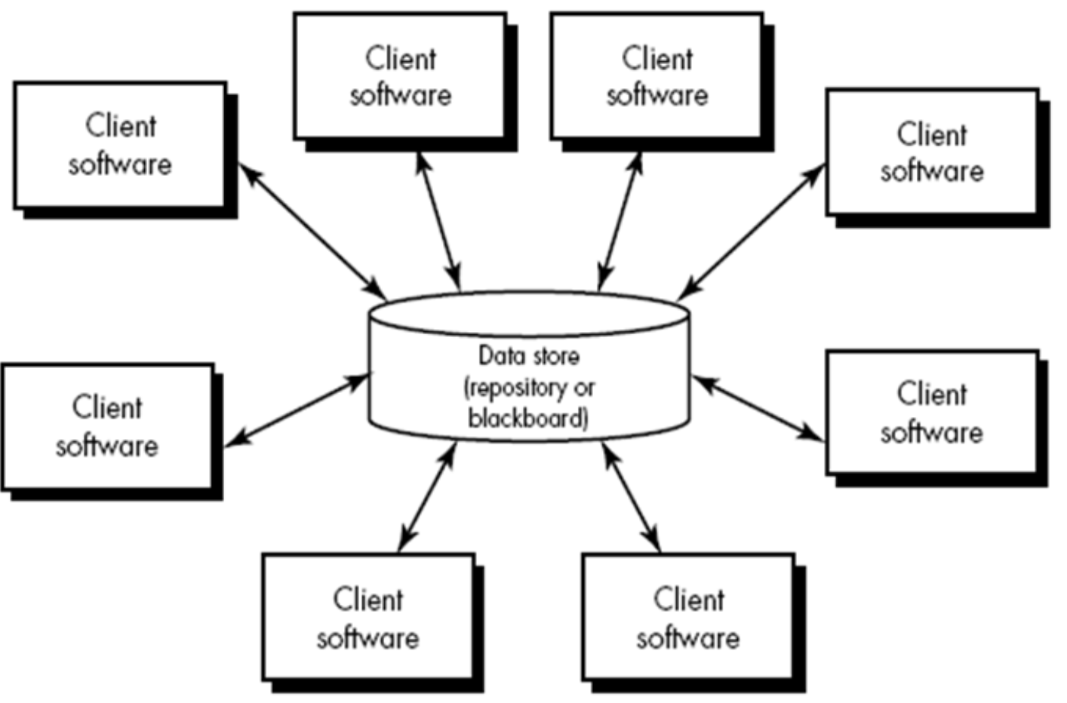
Data-Centered Architecture

Slide 28
Data-flow architectures
Shows the flow of input data, its computational components and output data
Structure is also called pipe and Filter
Pipe provides path for flow of data
Filters manipulate data and work independent of its neighboring filter
If data flow degenerates into a single line of transform, it is termed as batch sequential.

Slide 29
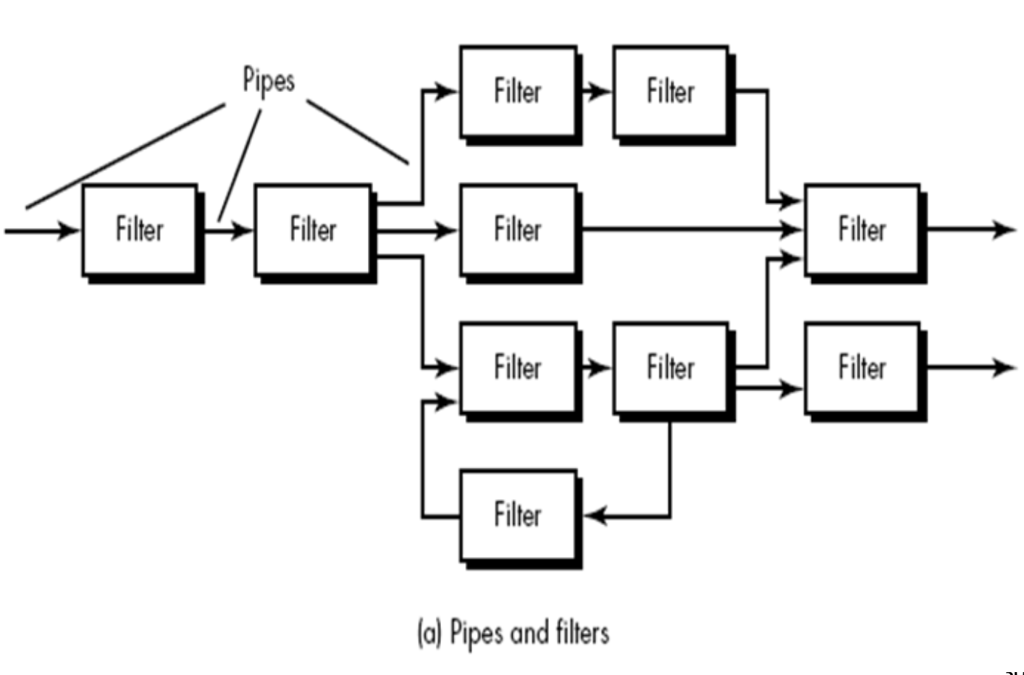
Data-flow architectures

Slide 30
Call and return Architectures
Achieves a structure that is easy to modify and scale Two sub styles are
1. Main program/subprogram Architecture
• Classic programs structure
• Main program invokes a number of components, which in turn invoke still other components
2. Remote procedure call Architecture
• Components of main program/subprogram are distributed across computers over network

Slide 31
Object-oriented architectures
• The components of a system encapsulate data and the operations
• Communication and coordination between components is done via message

Slide 32
Layered architectures
A number of different layers are defined – Inner Layer (interface with OS) – Intermediate Layer (Utility services and application function) – Outer Layer (User interface)

Slide 33
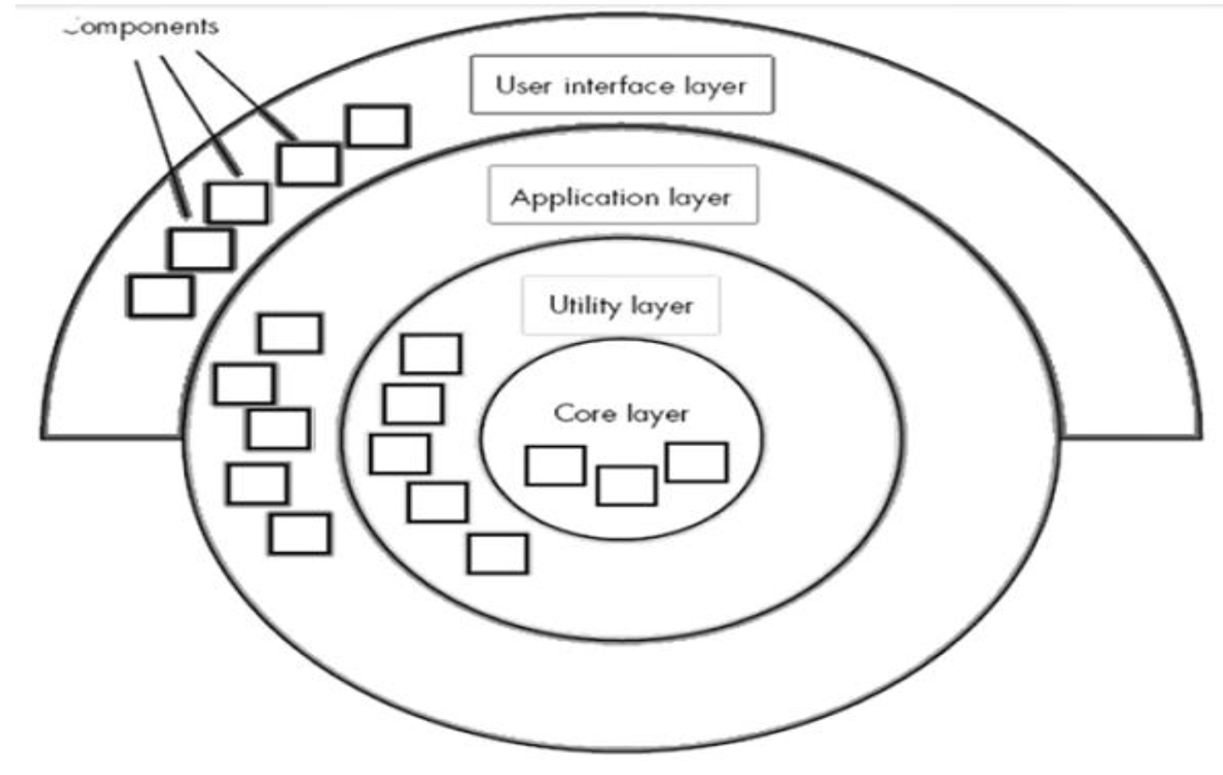
Layered architectures

Slide 34
Any questions?

Slide 35
Thank you

Slide 36
Scan The QR for More Info

