Slide 1
SOFTWARE ENGINEERING
UNIT –III (Part - 1)
SYSTEM MODELS
Text Book: Software Engineering, A practitioner’s approach
Roger s. Pressman 6th Edition -McGraw-Hill

Slide 2
Topics covered
Context models
Behavioural models
Data models
Object models
CASE workbenches

Slide 3
System models
Abstract descriptions of systems whose requirements are being analysed.

Slide 4
System modelling
System modelling helps the analyst to understand the functionality of the system and models are used to communicate with customers
Different models present the system from different perspectives
External perspective showing the system’s context or environment
Behavioural perspective showing the behaviour of the system
Structural perspective showing the system or data architecture

Slide 5
Types of System Models
Data flow model showing how the data is processed at different stages
Composition model showing how entities are composed of other entities
Architectural model showing principal subsystems that make up a system
Classification model (Object diagrams) showing how entities have common characteristics
Stimulus/response model showing the system’s reaction to internal and external events

Slide 6
Context models
Context models are used to illustrate the boundaries of a system
Social and organisational concerns may affect the decision on where to position system boundaries
Architectural models show that a system and its relationship with other systems

Slide 7
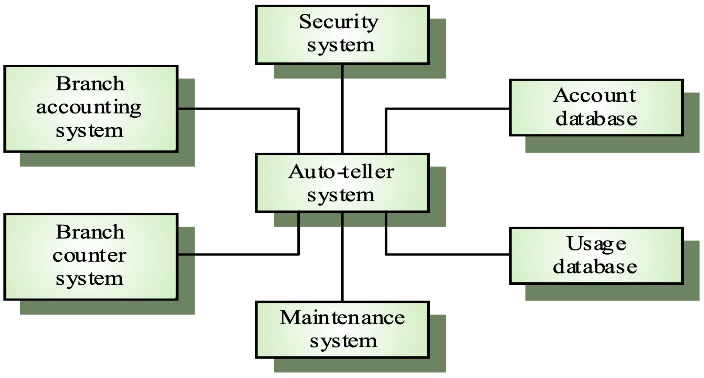
The context of an ATM system

Slide 8
Behavioural models
Behavioural models are used to describe the overall behaviour of a system
Two types of behavioural models are
Data processing models that show how data is processed as it moves through the system
State machine models that show the systems response to events

Slide 9
Data-flow Models
Data Flow Diagrams model the system from a functional perspective
Tracking and documenting how the data associated with a process is helpful to develop an overall understanding of the system
Data flow diagrams may also be used in showing the data exchange between a system and other systems in its environment

Slide 10
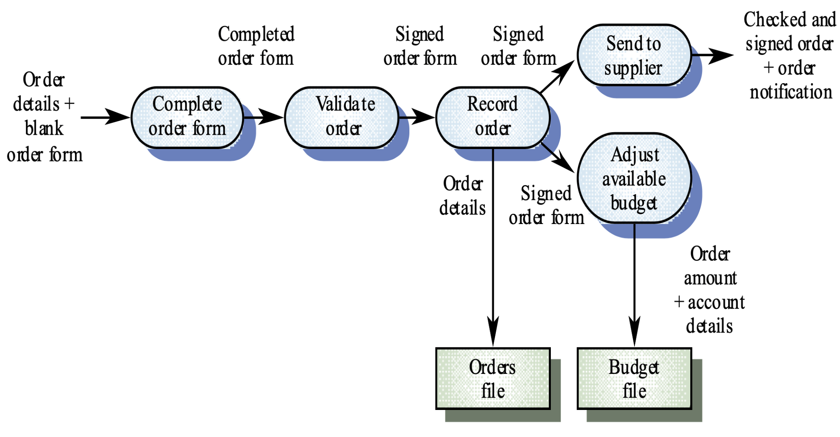
Order processing DFD

Slide 11
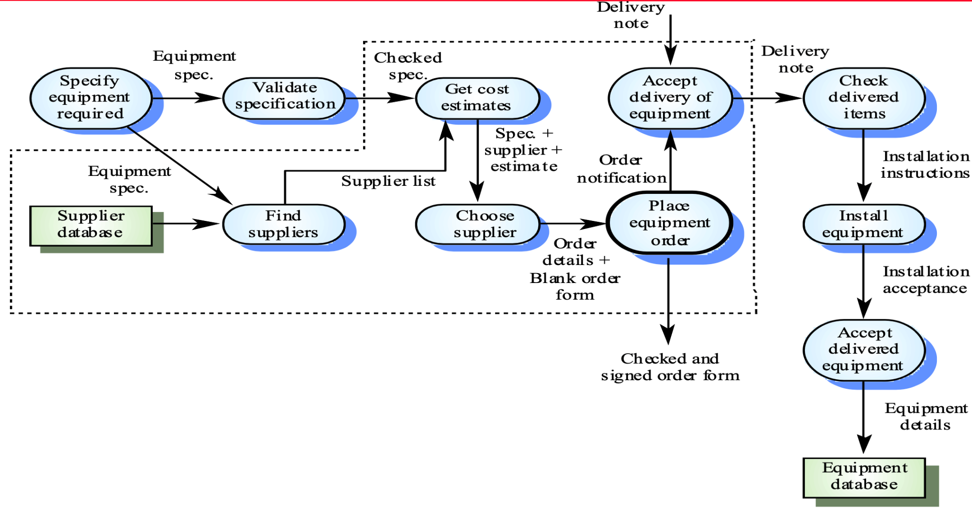
Equipment procurement process

Slide 12
State machine models
These model the behaviour of the system in response to external and internal events
They show the system’s responses to stimuli so are often used for modelling real-time systems
State machine models show system states as nodes and events as arcs between these nodes. When an event occurs, the system moves from one state to another

Slide 13
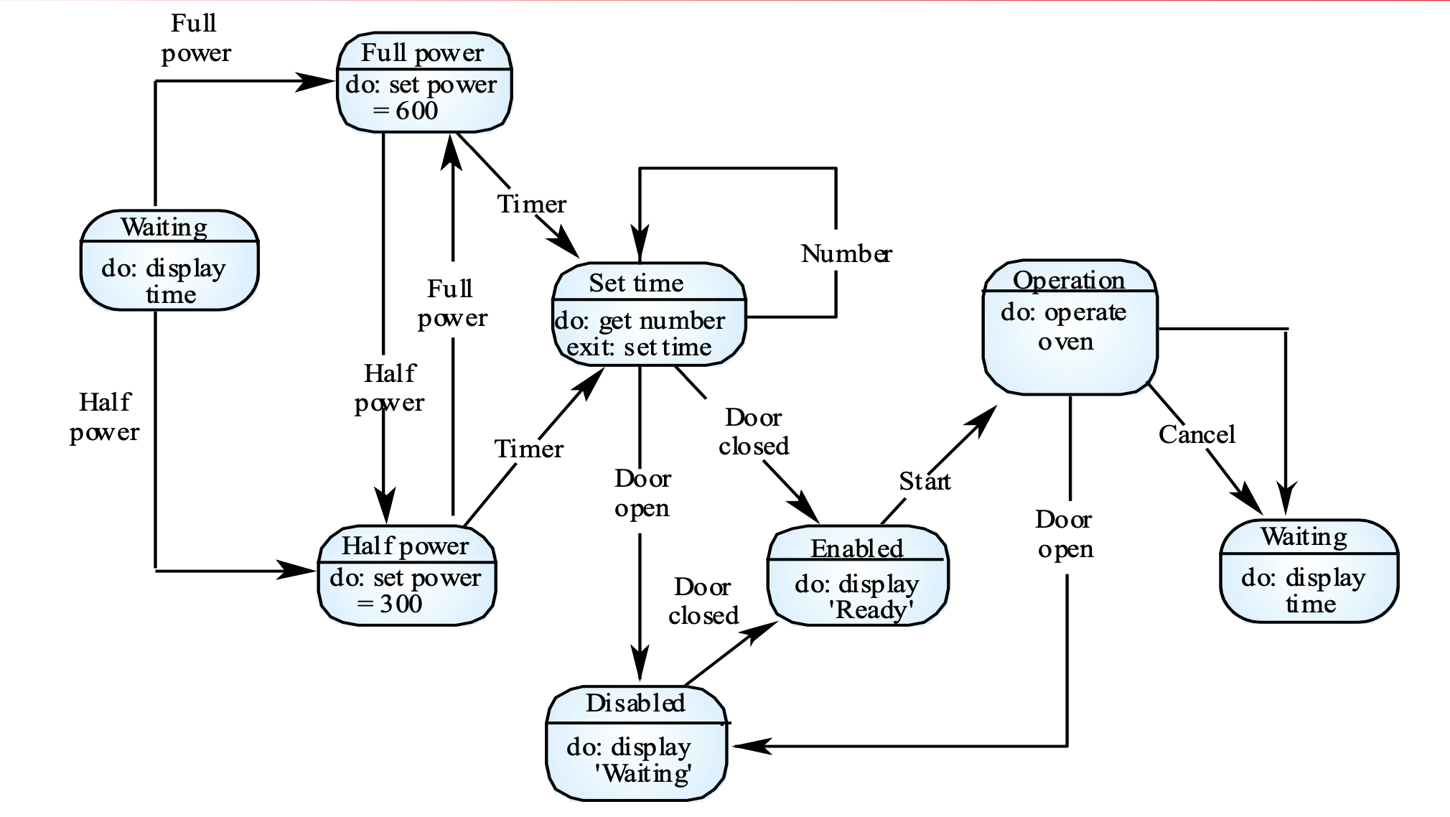
Microwave oven model

Slide 14
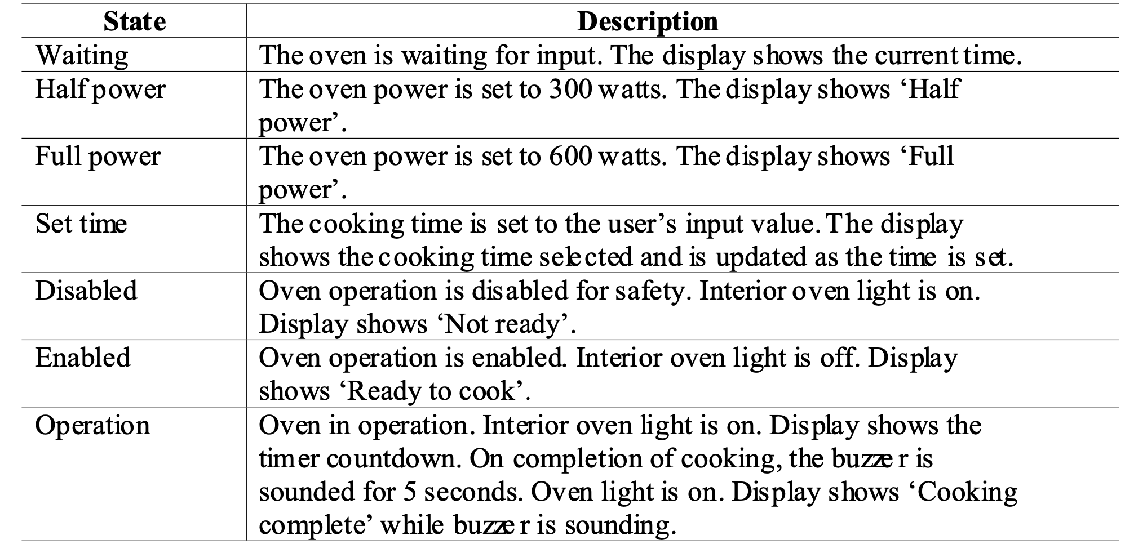
State and stimulus description for the Microwave oven

Slide 15
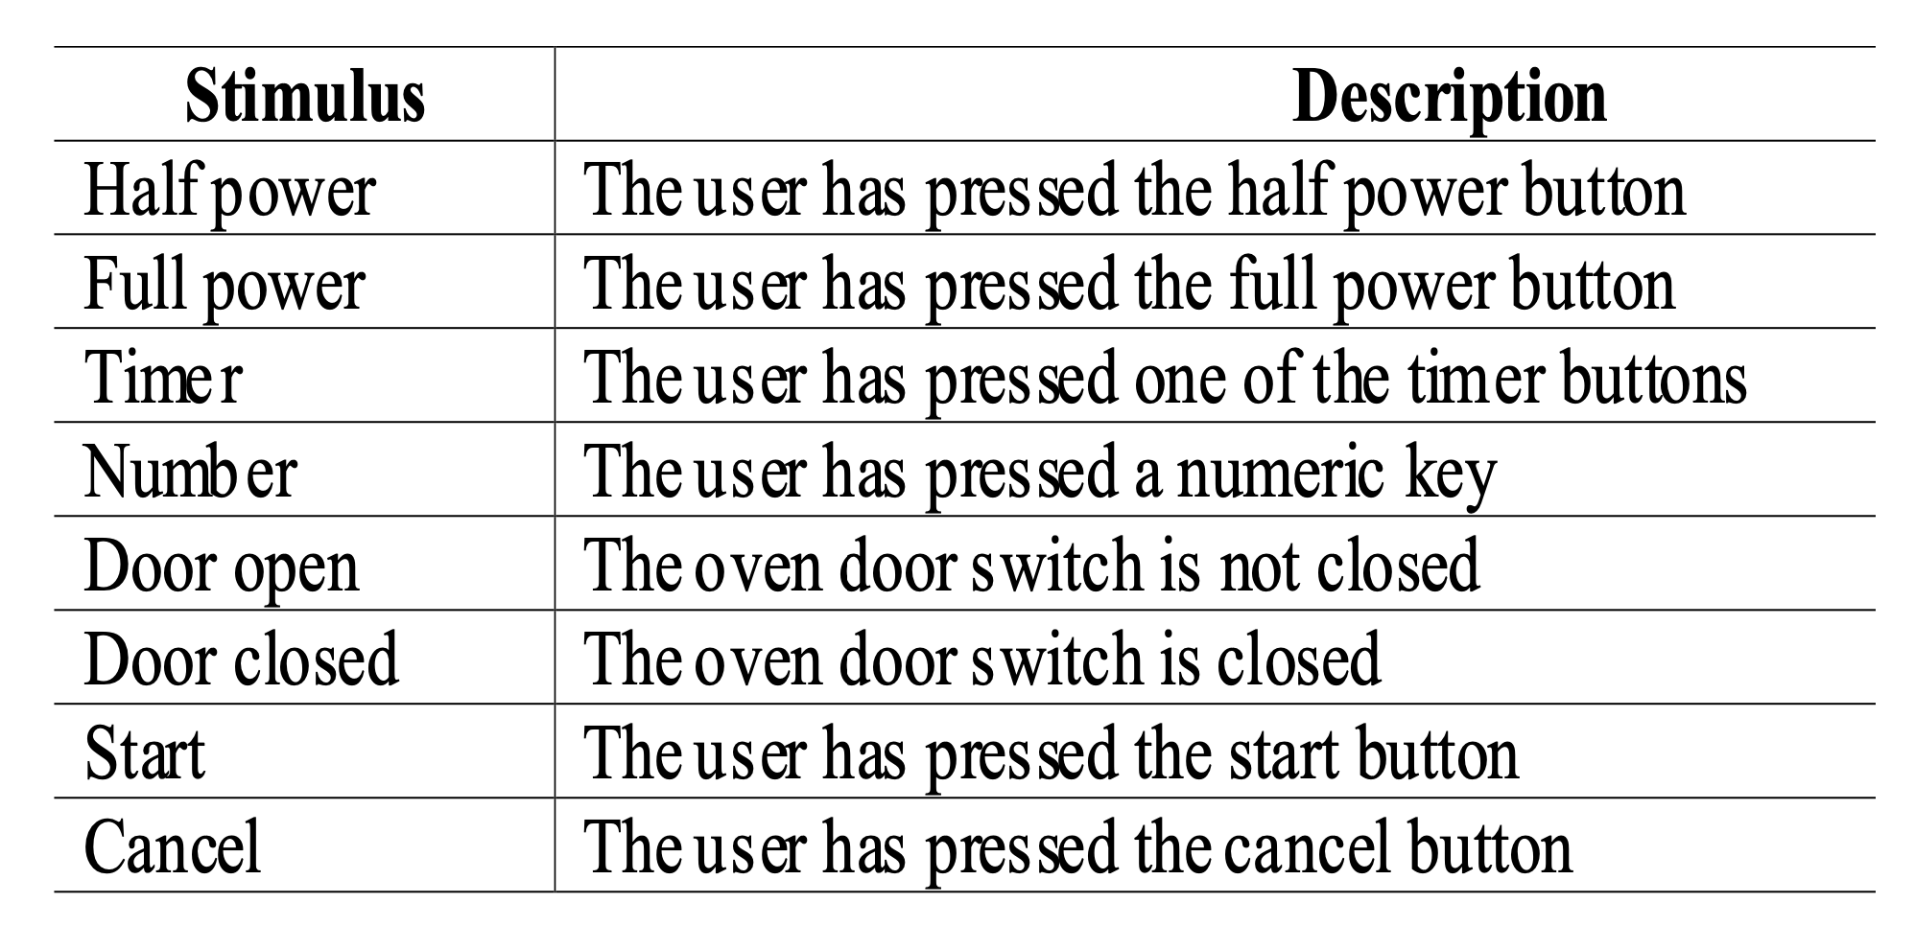
Microwave oven stimuli

Slide 16
Semantic data models
Used to describe the logical structure of data processed by the system
Entity-relation-attribute model sets out the entities in the system, the relationships between these entities and the entity attributes
Widely used in database design. Can readily be implemented using relational databases

Slide 17
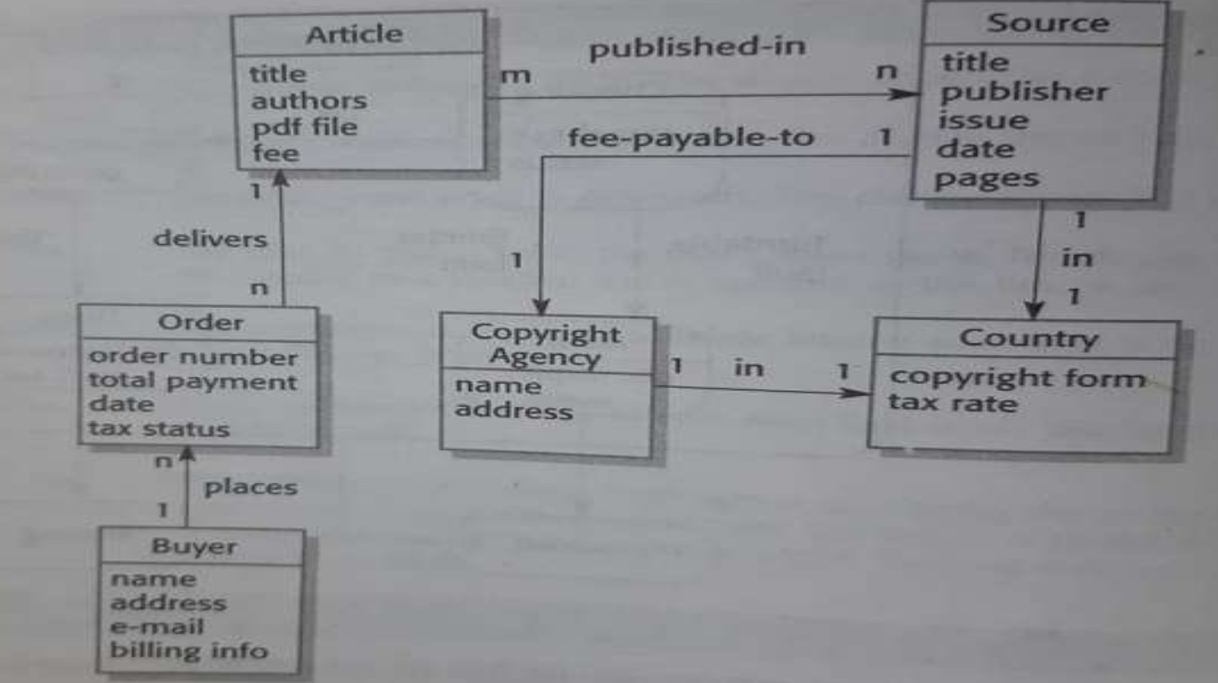
Semantic data models for Library system

Slide 18
Data dictionaries
Data dictionaries are lists of all of the names used in the system models. Descriptions of the entities, relationships and attributes are also included
Advantages
Support name management and avoid duplication
Store of organisational knowledge linking analysis, design and implementation

Slide 19
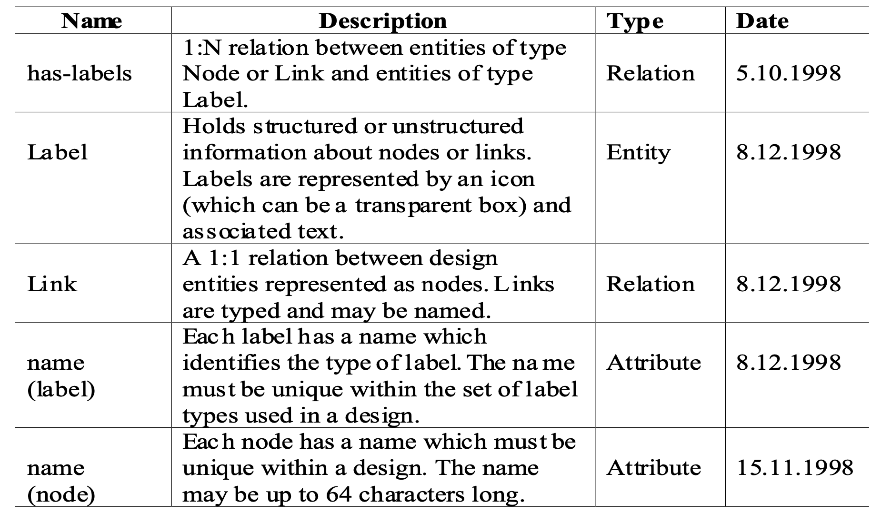
Data dictionary entries

Slide 20
Object Models
Object models describe the system in terms of object classes
An object class is an abstraction over a set of objects with common attributes and the services (operations) provided by each object
Various object models may be produced
Inheritance models
Aggregation models
Interaction models

Slide 21
Object models
Natural ways of reflecting the real-world entities manipulated by the system
More abstract entities are more difficult to model using this approach
Object class identification is recognised as a difficult process requiring a deep understanding of the application domain
Object classes reflecting domain entities are reusable across systems

Slide 22
Inheritance models
Organise the domain object classes into a hierarchy
Classes at the top of the hierarchy reflect the common features of all classes
Object classes inherit their attributes and services from one or more super-classes. these may then be specialised as necessary
Class hierarchy design is a difficult process if duplication in different branches is to be avoided

Slide 23
The Unified Modelling Language
Devised by the developers of widely used object- oriented analysis and design methods
Has become an effective standard for object-oriented modelling Notation
Object classes are rectangles with the name at the top, attributes in the middle section and operations in the bottom section
Relationships between object classes (known as associations) are shown as lines linking objects
Inheritance is referred to as generalisation and is shown ‘upwards’ rather than ‘downwards’ in a hierarchy

Slide 24
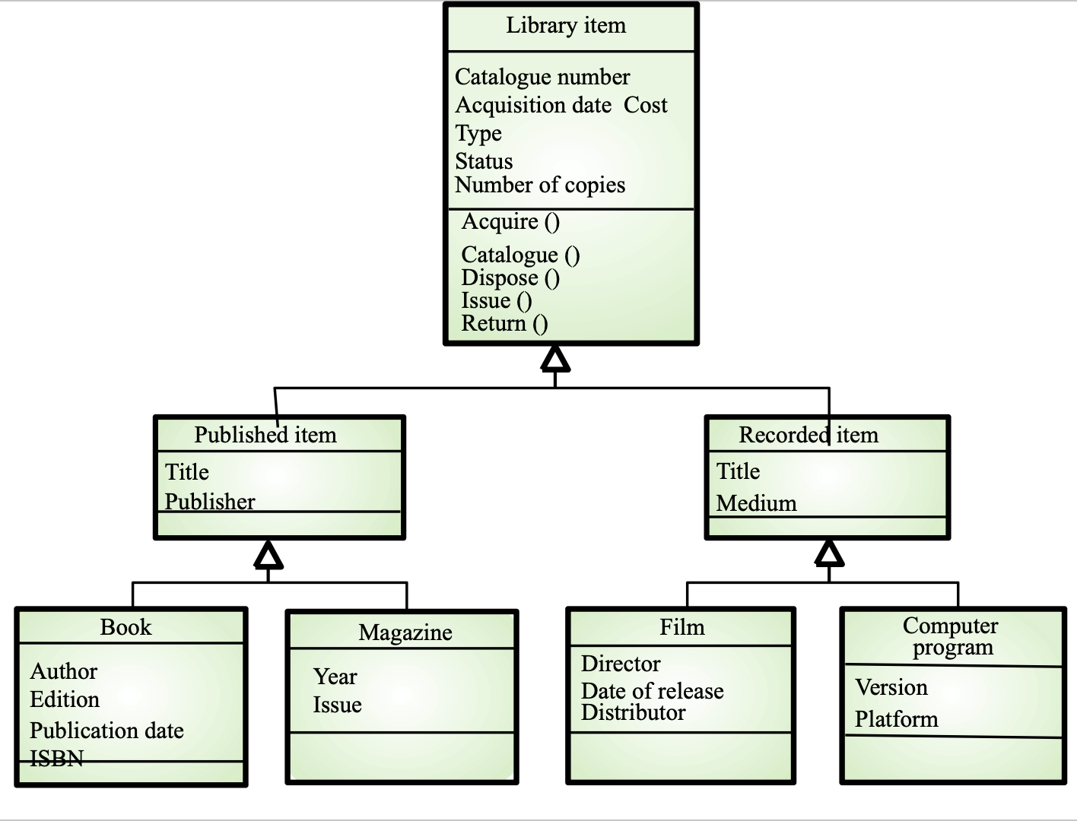
Library class hierarchy

Slide 25
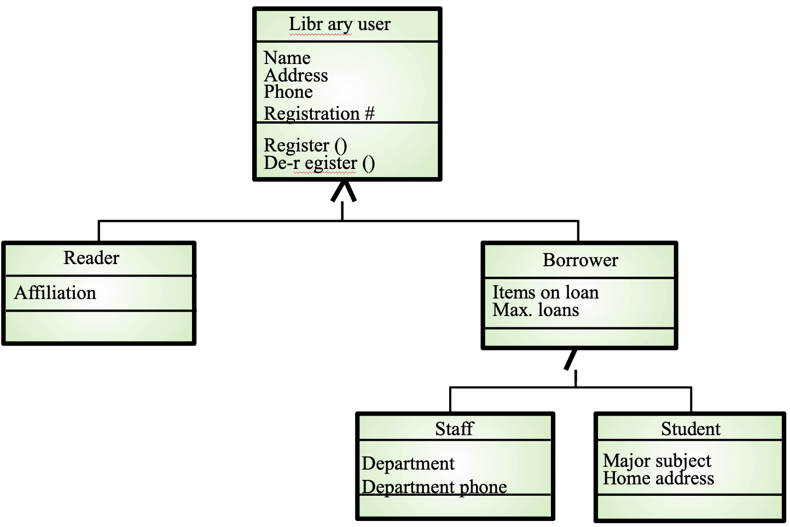
User class hierarchy

Slide 26
Multiple Inheritance
Rather than inheriting the attributes and services from a single parent class, a system which supports multiple inheritance allows object classes to inherit from several superclasses
Can lead to semantic conflicts where attributes/ services with the same name in different super- classes have different semantics
Makes class hierarchy reorganisation more complex

Slide 27
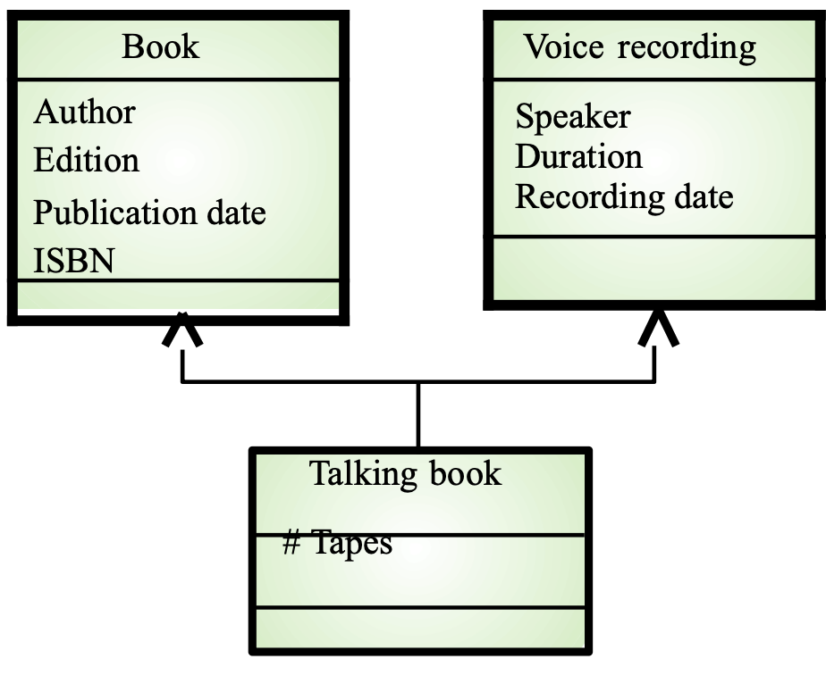
Multiple Inheritance

Slide 28
CASE workbenches
(Computer Aided Software Engineering)
A coherent set of tools that is designed to support related software process activities such as analysis, design, implementation or testing
Analysis and design workbenches support system modelling during both requirements engineering and system design
These workbenches may support a specific design method or may provide support for creating several different types of system model

Slide 29
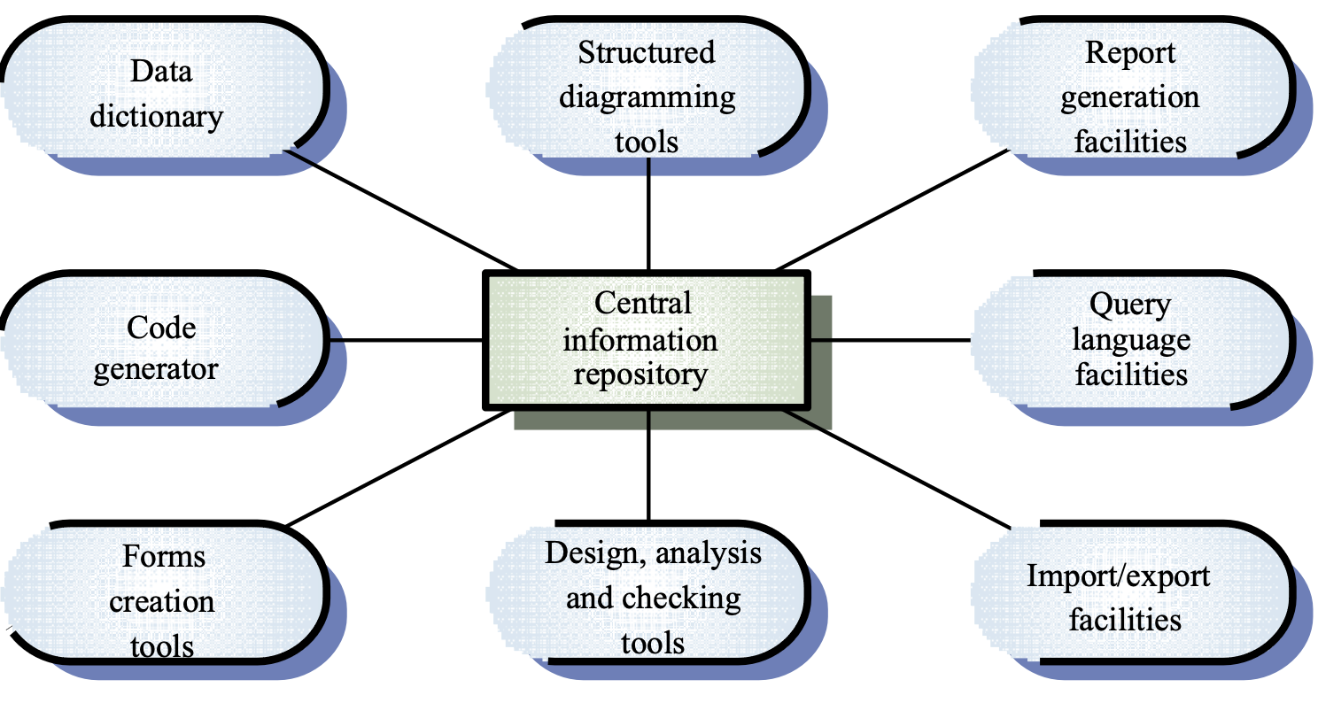
Components of a CASE tool

Slide 30
Method support tools
Diagram editors
Model analysis and checking tools
Repository and associated query language
Data dictionary
Report definition and generation tools
Forms definition tools
Import/export facilities
Code generation tools

Slide 31
Elements Of Computer Science and Engineering
Any questions?

Slide 32
Thank you

Slide 33
Elements Of Computer Science and Engineering
Scan The QR for More Info

